Slide 1


Slide 2
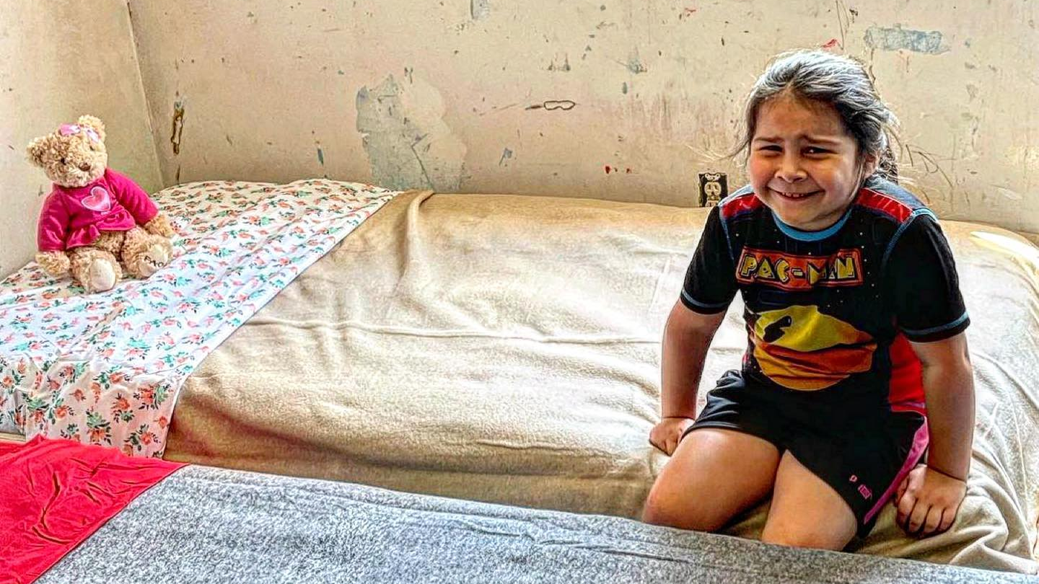

Slide 3
This is why we do what we do!
Maria is a sweet 8-year-old girl who had been sleeping on the couch with her teddy bear. Bed Brigade volunteers were able to provide her very own bed for the first time in her life ❤️. She was so happy to receive this bed, she cried.

Slide 4
This is why we do what we do!
Unfortunately, Maria is just one of hundreds of children and families in our local community who deal with bed insecurity.

Slide 5
This is why we do what we do!
Currently we have nearly 500 people in central Ohio waiting on a bed.

Slide 6
This is why we do what we do!
That’s just the beginning.

Slide 7
This is why we do what we do!
There are an estimated 3,000,000 children in the United States without a bed to sleep in.
Our goal is to help them physically and spiritually, REST IN JESUS.
Bed Brigade needs your help to meet that need.

Slide 8
How did we get started?

Slide 9
How did we get started?
The original Bed Brigade started about 12-15 years ago as an outreach by Vineyard Church in Circleville, OH.
About 10 years ago, Bed Brigade of Columbus started and really paved the way for where we are today.
In October 2021, God brought Matt, Dave, and Christian together to pick-up the mantle and run with it. Together we started Bed Brigade (Polaris) and www.bedbrigade.org (a registered 501c3) which will become the National/International presence of Bed Brigade.
Since then, Bed Brigade (Polaris) has delivered over 300 beds in Central Ohio and lead 6 people to a relationship with Christ.

Slide 10
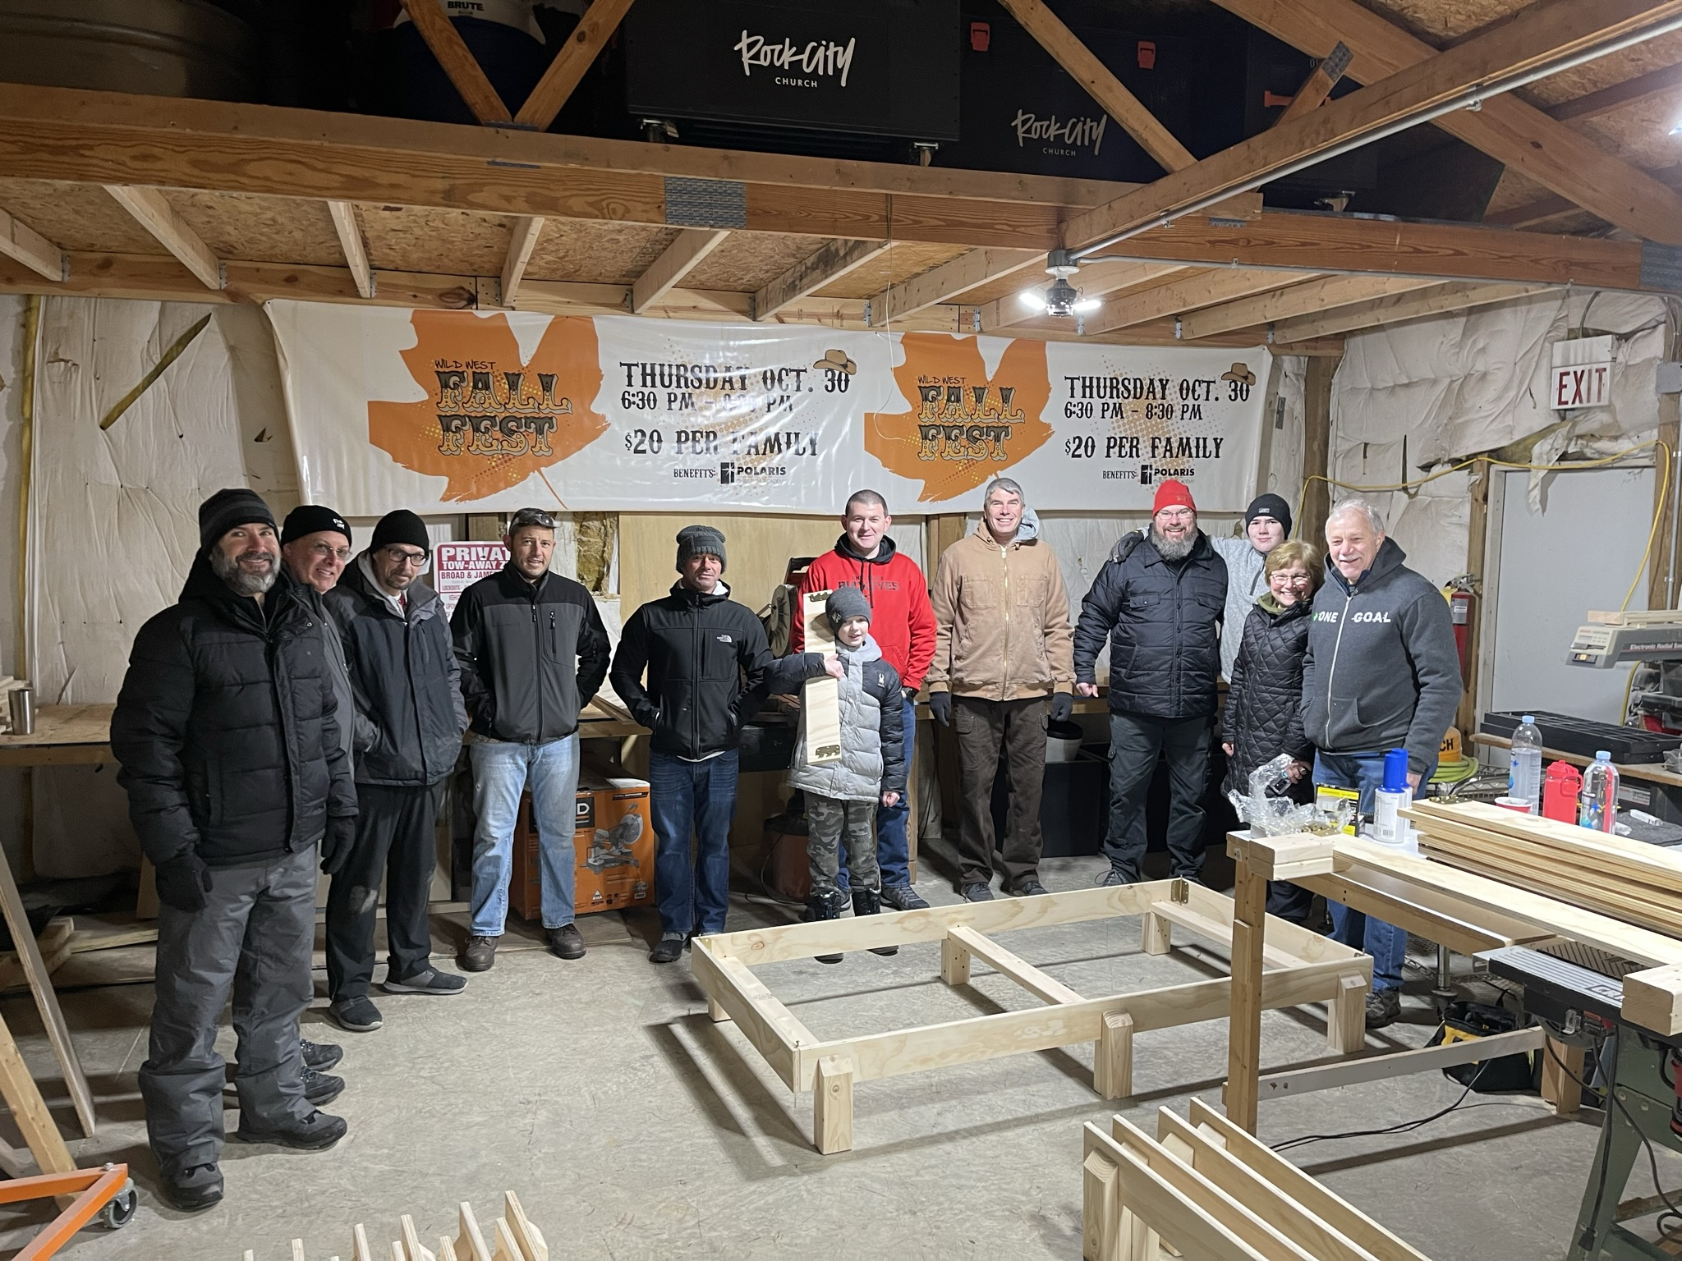
First Bed Brigade Build
January 2022

Slide 11
What do we do?

Slide 12
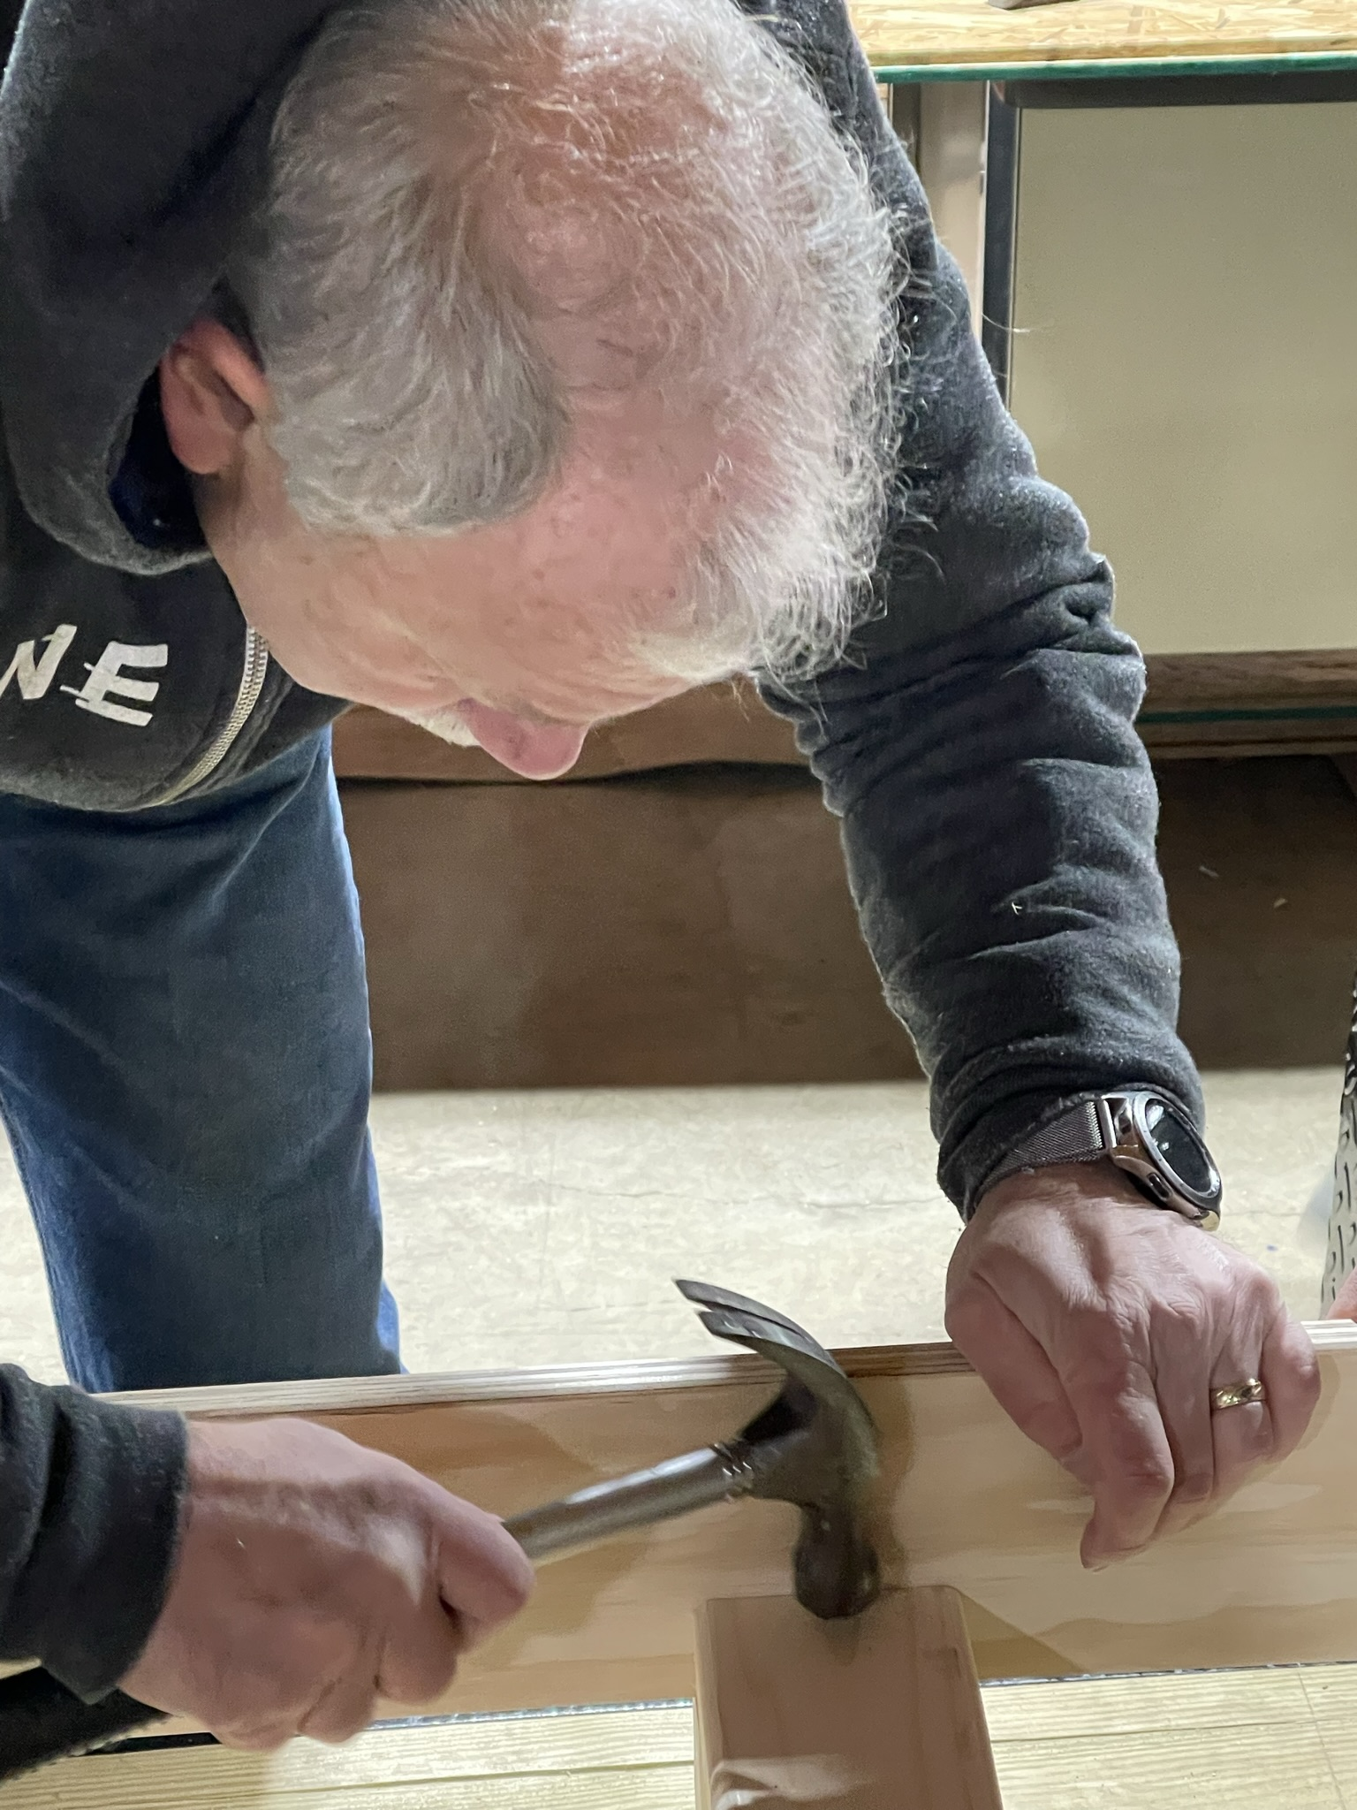
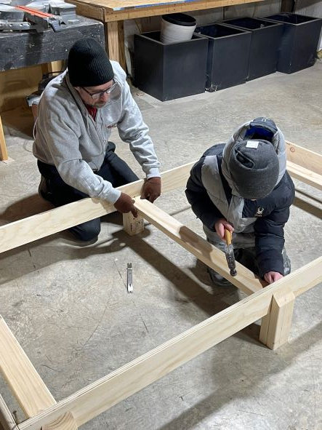
We build and provide awesome beds!

Slide 13
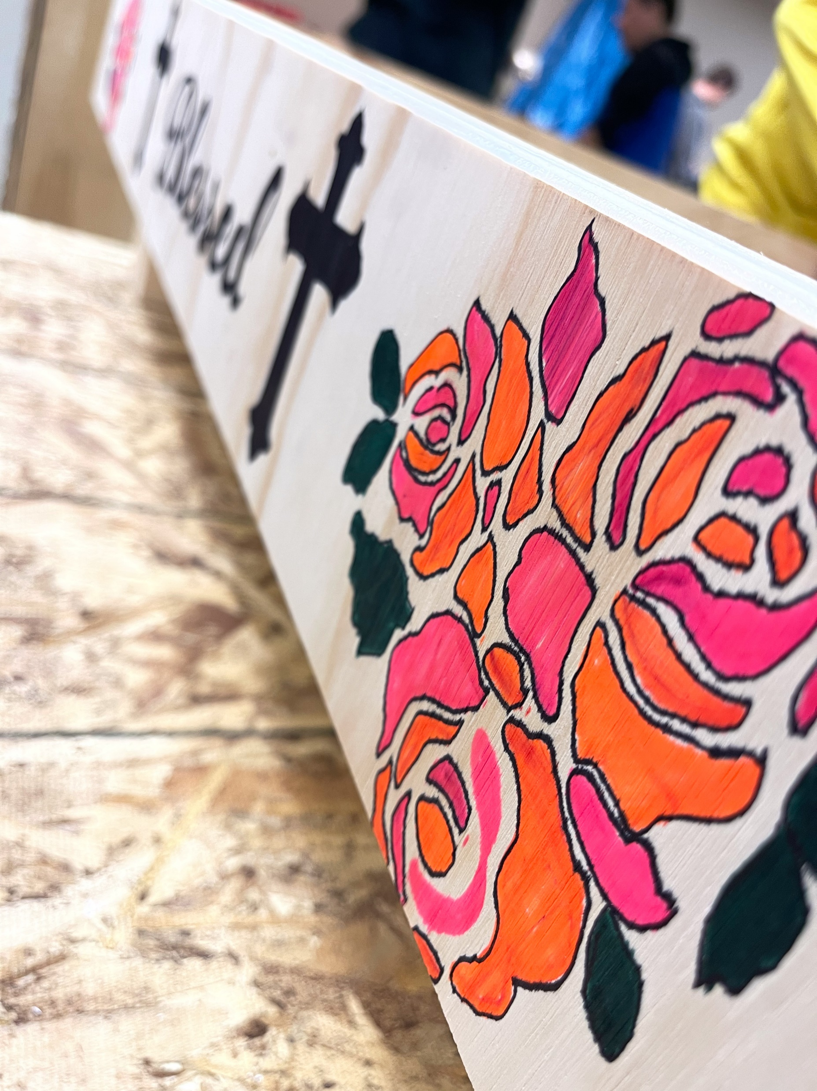

Slide 14
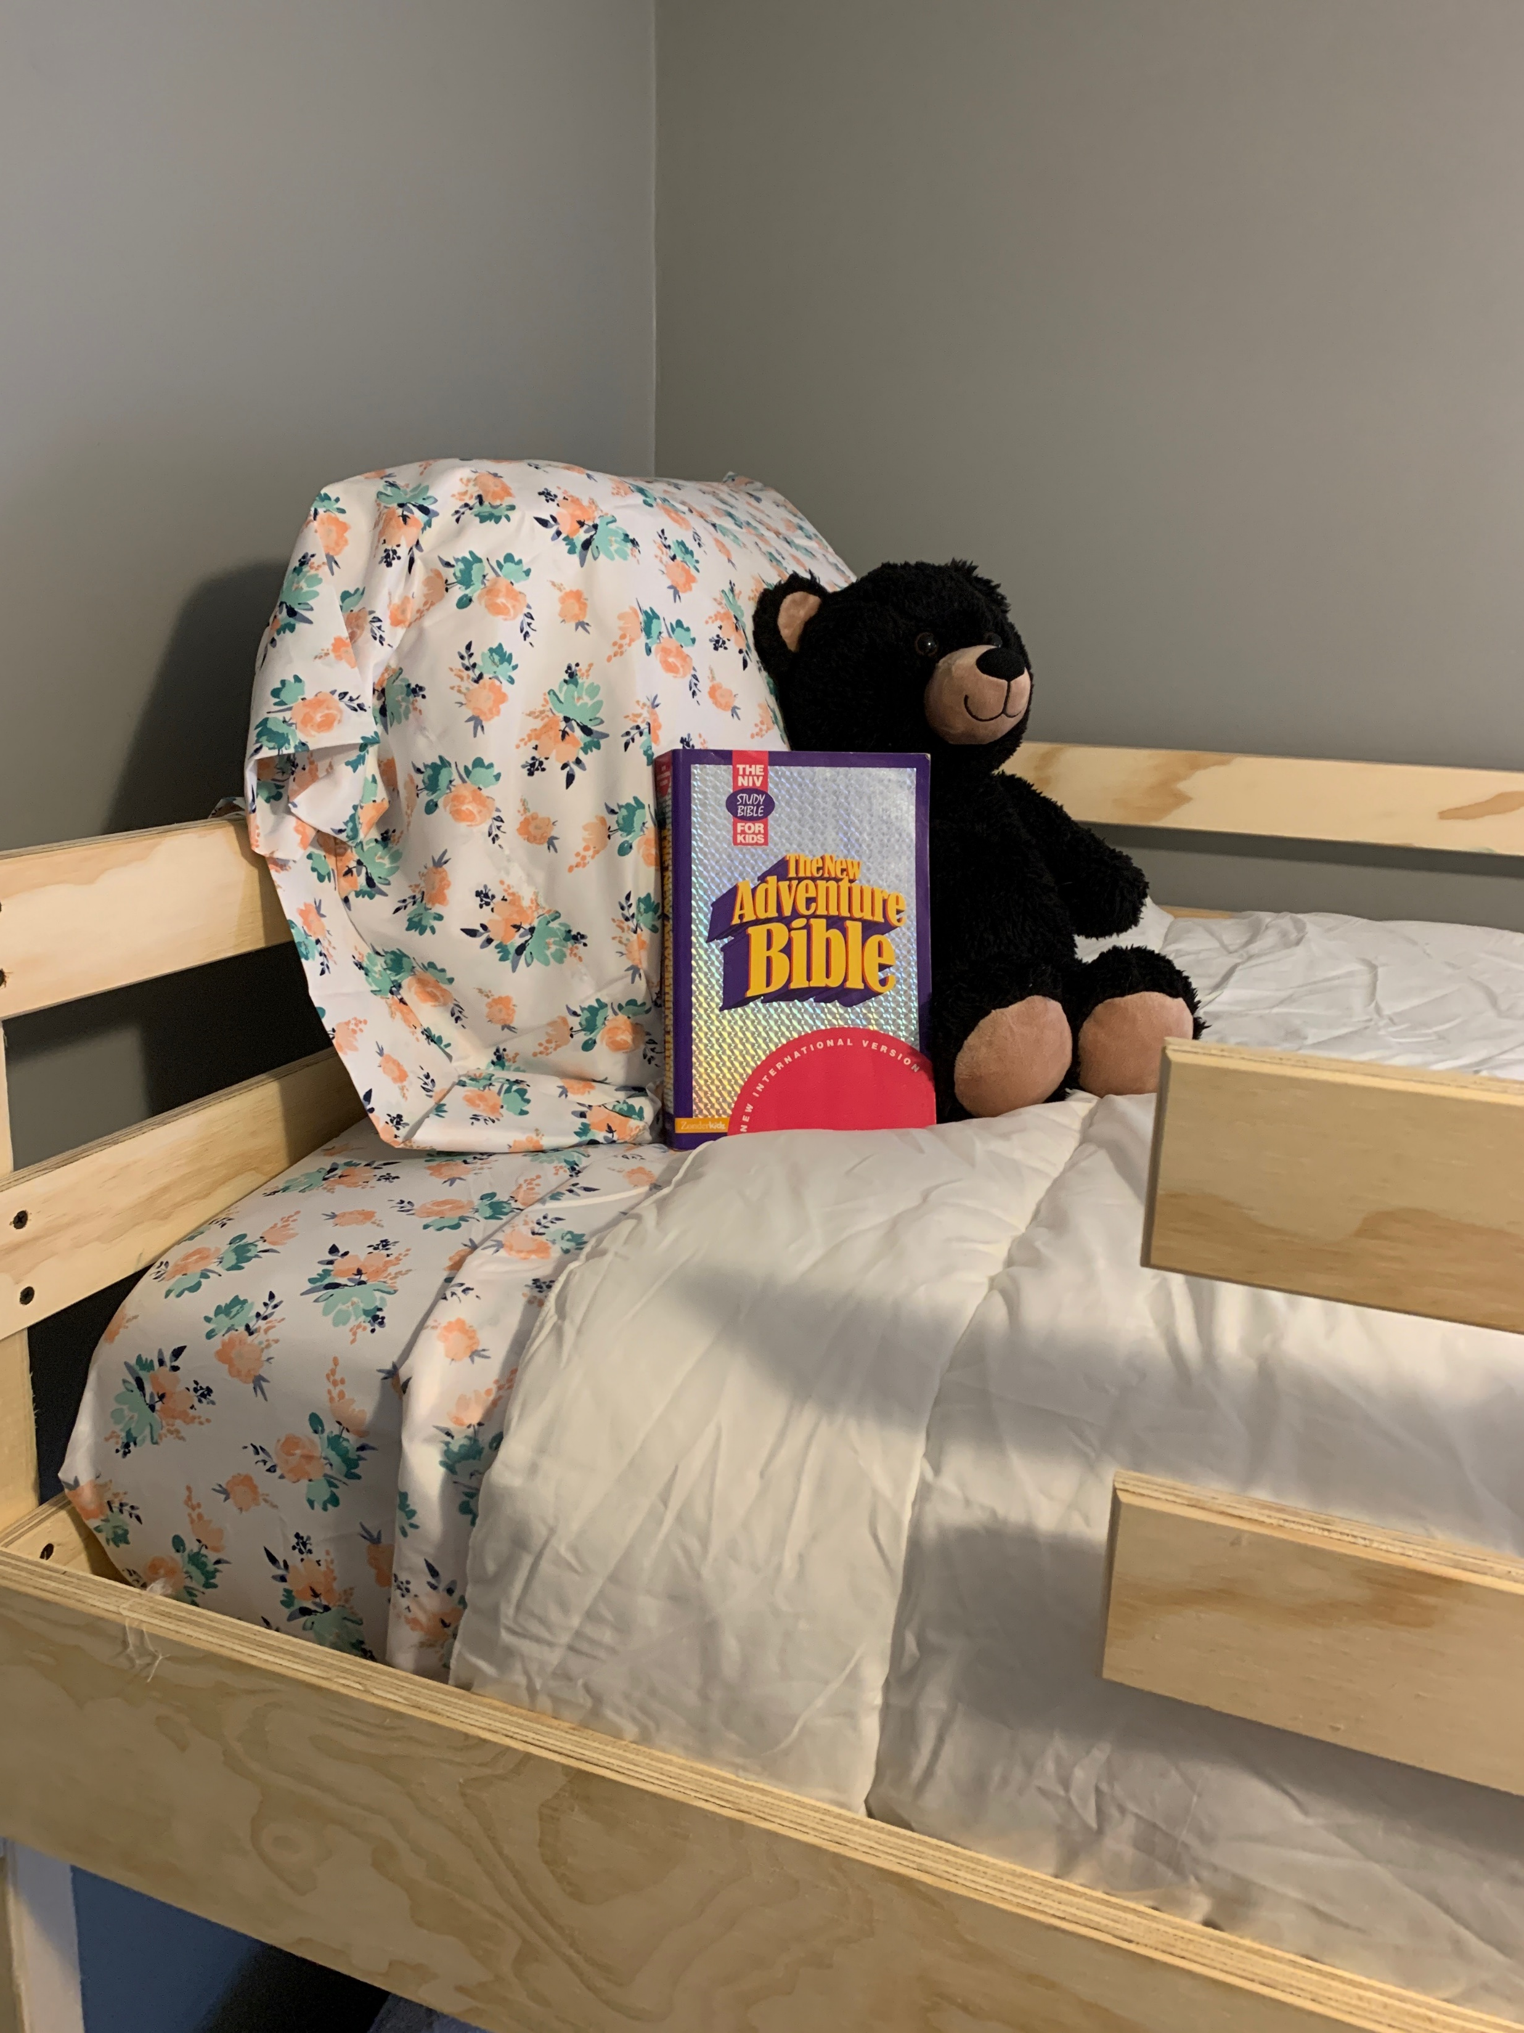
Every recipient gets:
A twin XL bed with a gently used mattress
Bedding (sheets, pillow, pillowcase and blanket
Age-appropriate toy or stuffy
Age-appropriate Bible

Slide 15
We pull together awesome teams of volunteers to build beds!
(Consider us for your next small group or corporate outing!!!)

Slide 16
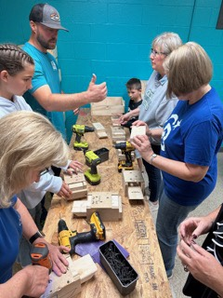

Slide 17
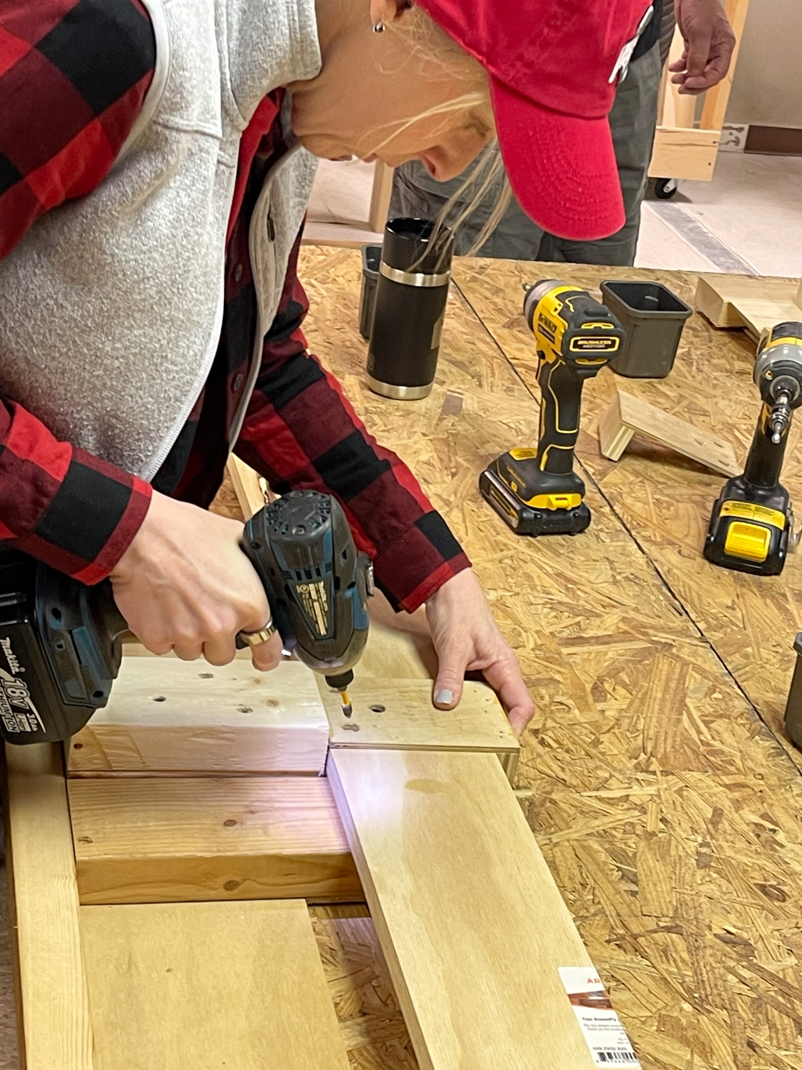

Slide 18
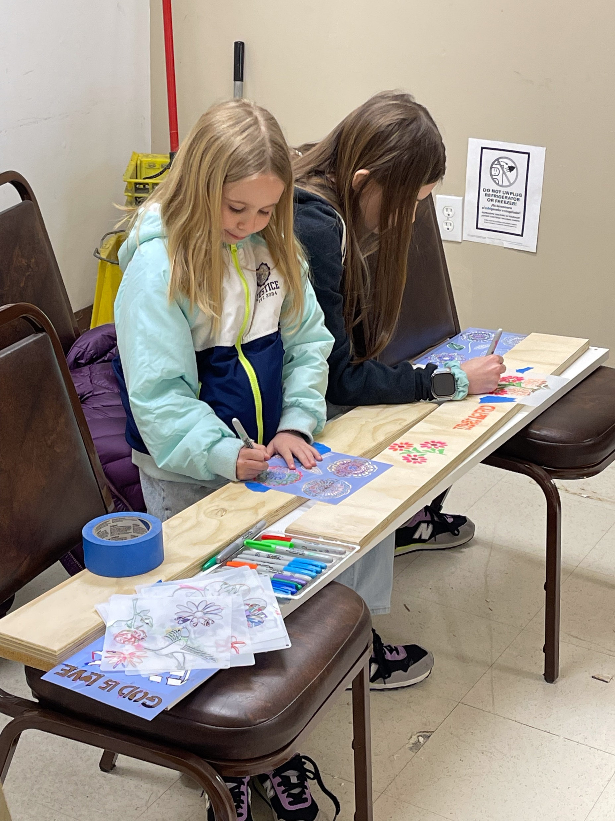
We try to involve the whole family!

Slide 19
We pray over every bed and every family.

Slide 20
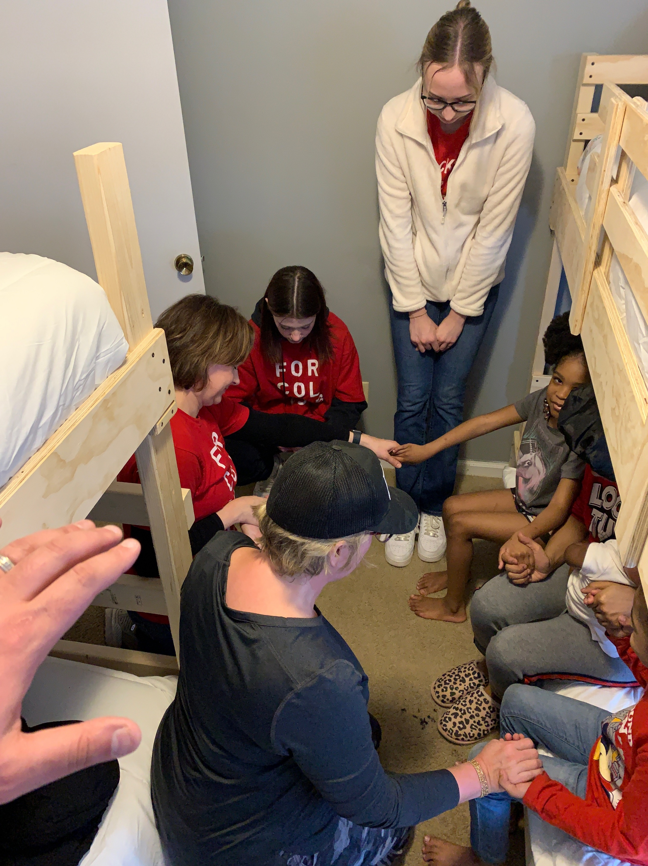

Slide 21
We work with churches and small groups to deliver and setup beds in recipients homes!
This is a great way to be the hands and feet of Jesus!!!

Slide 22
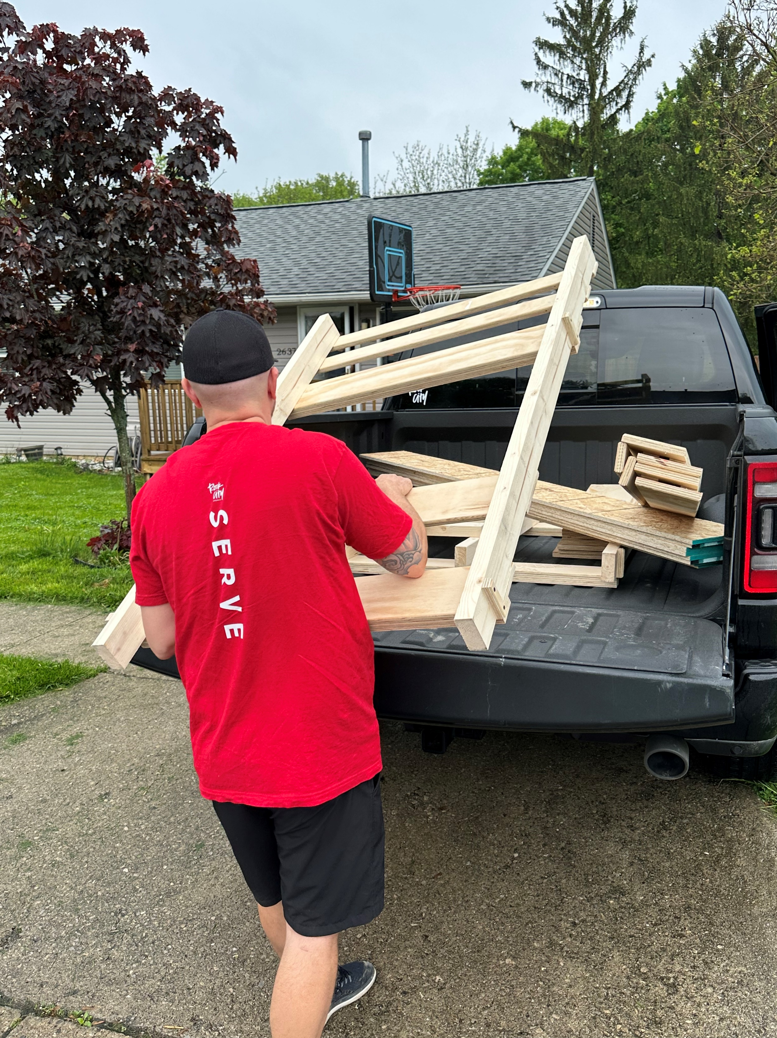

Slide 23
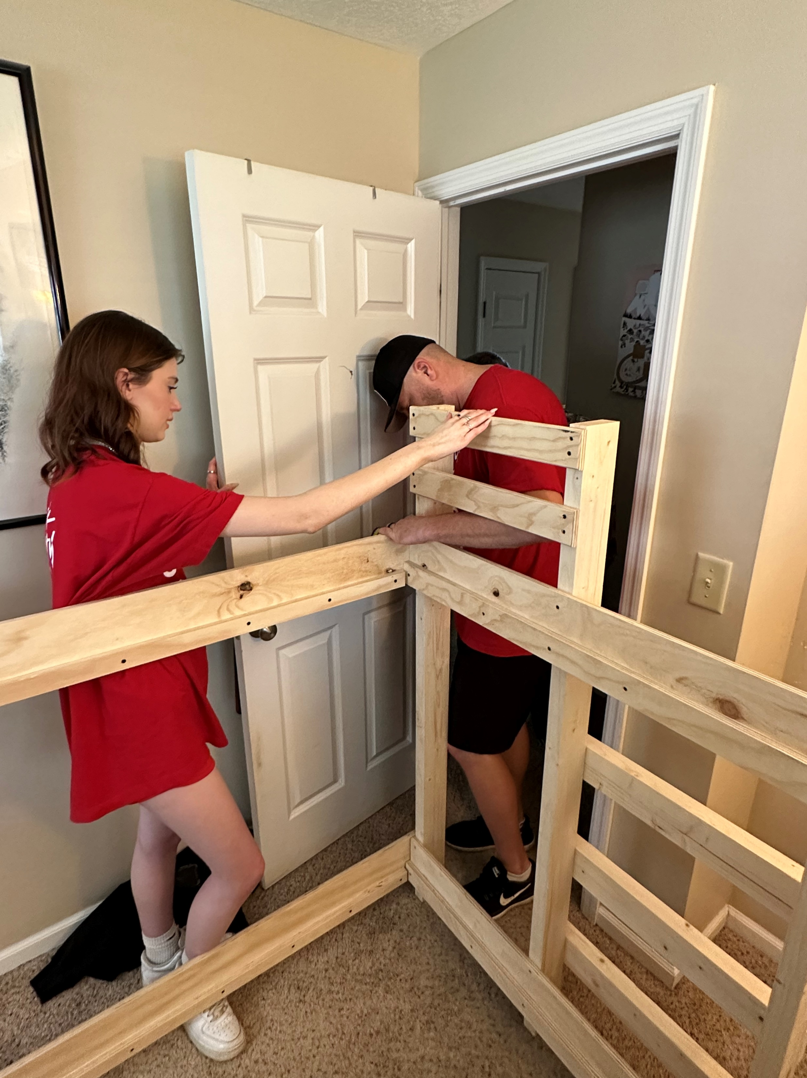

Slide 24
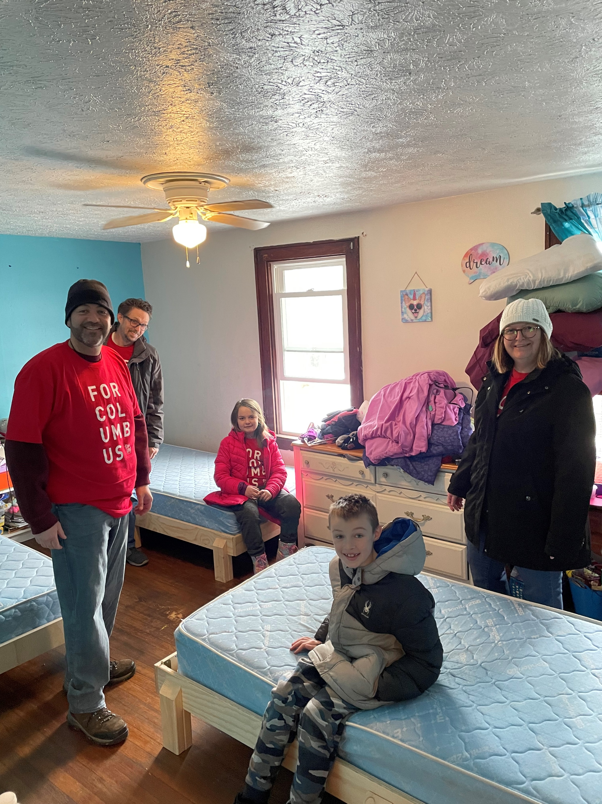

Slide 25
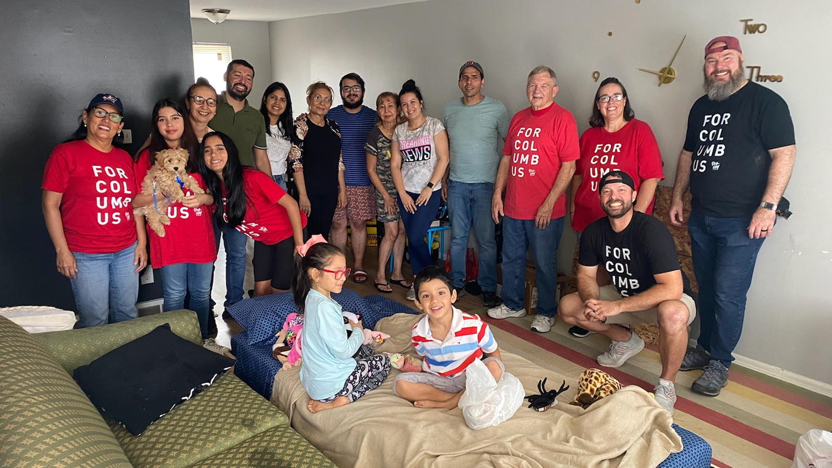

Slide 26
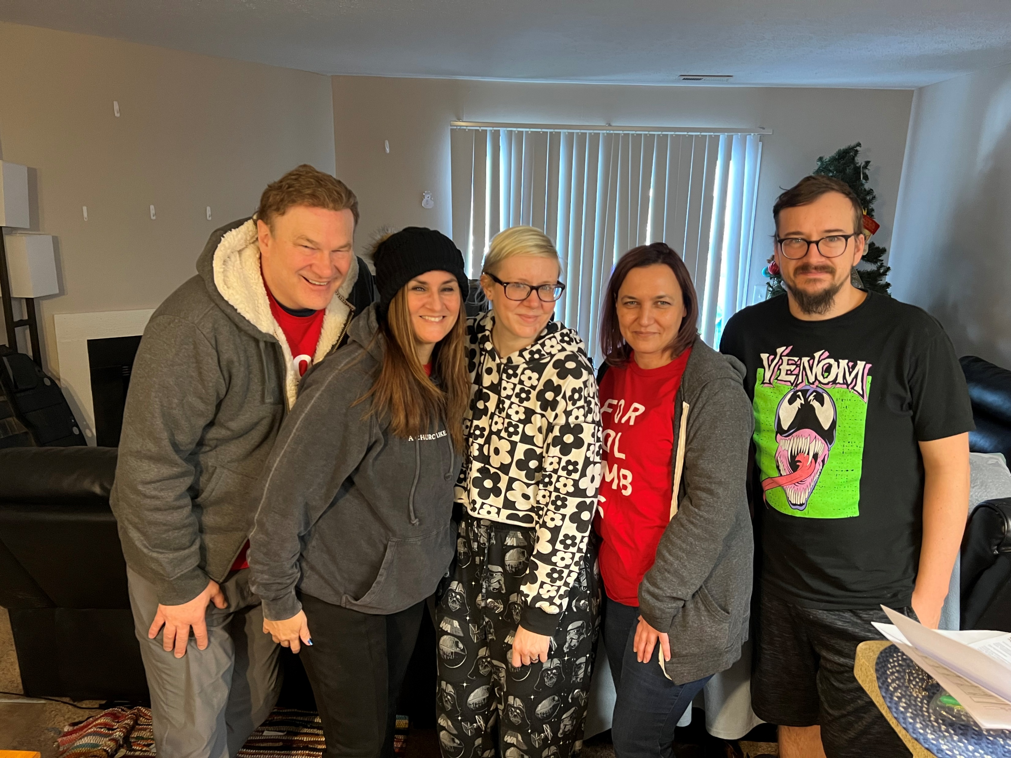

Slide 27
We always leave things a little nicer than when we arrive!

Slide 28
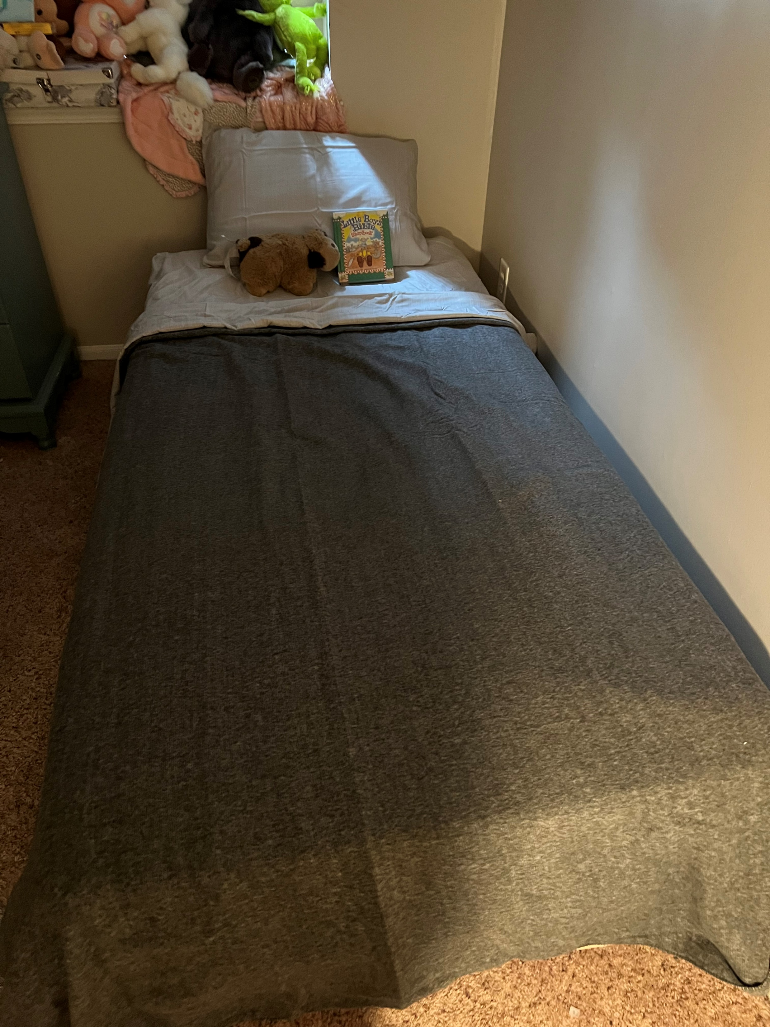
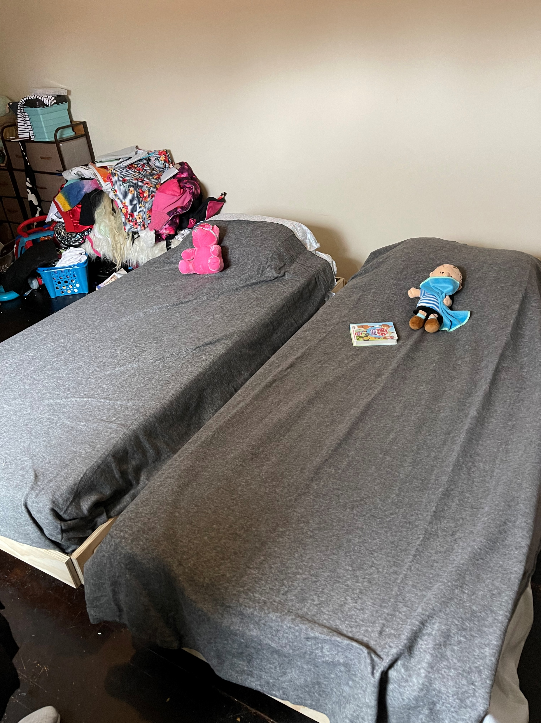

Slide 29
Check out some other recipients!

Slide 30
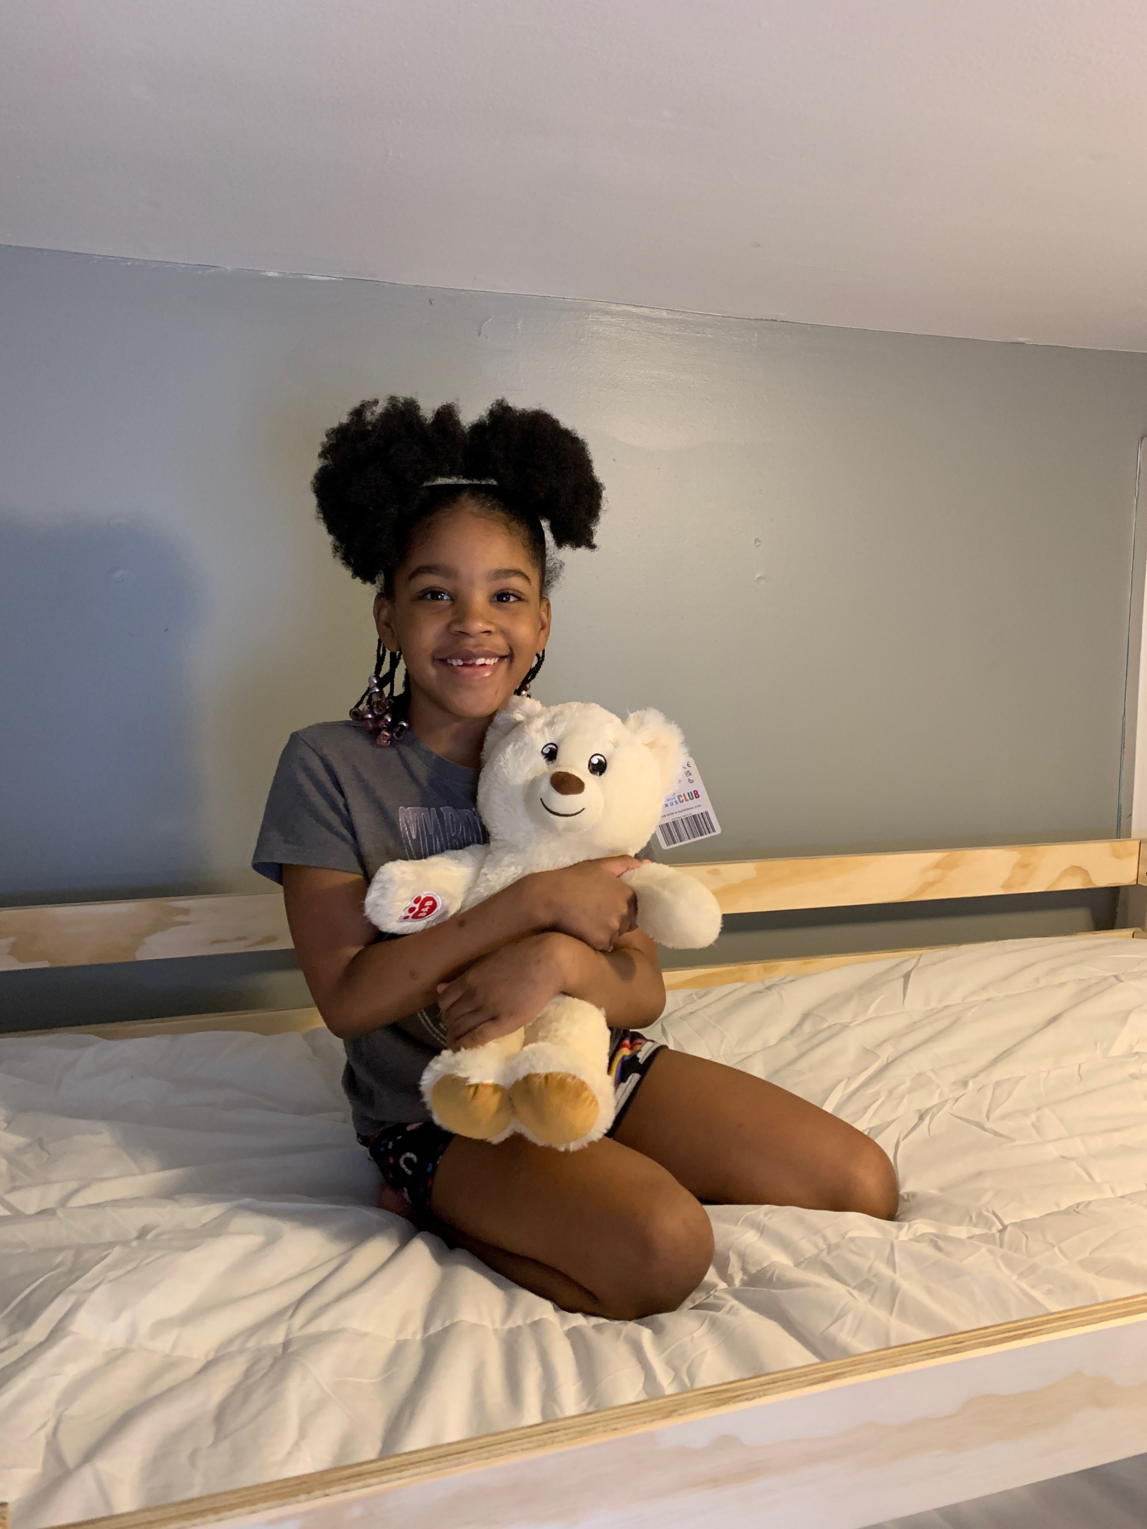

Slide 31
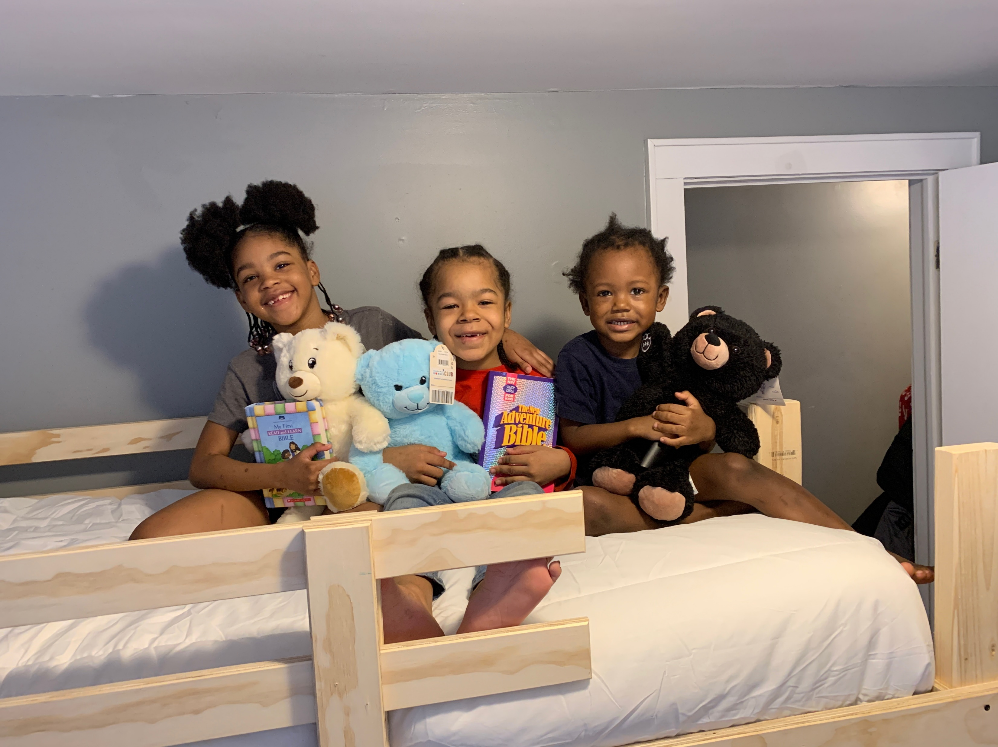

Slide 32
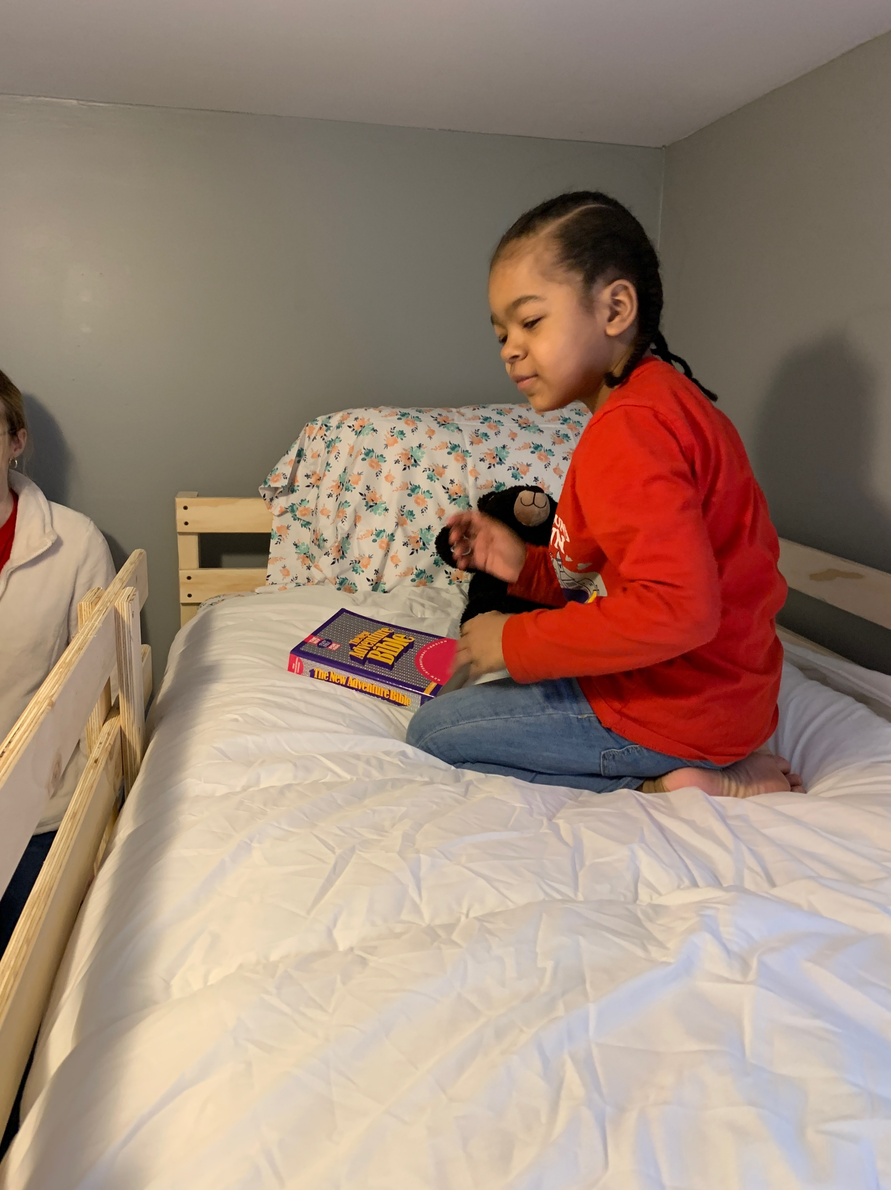

Slide 33
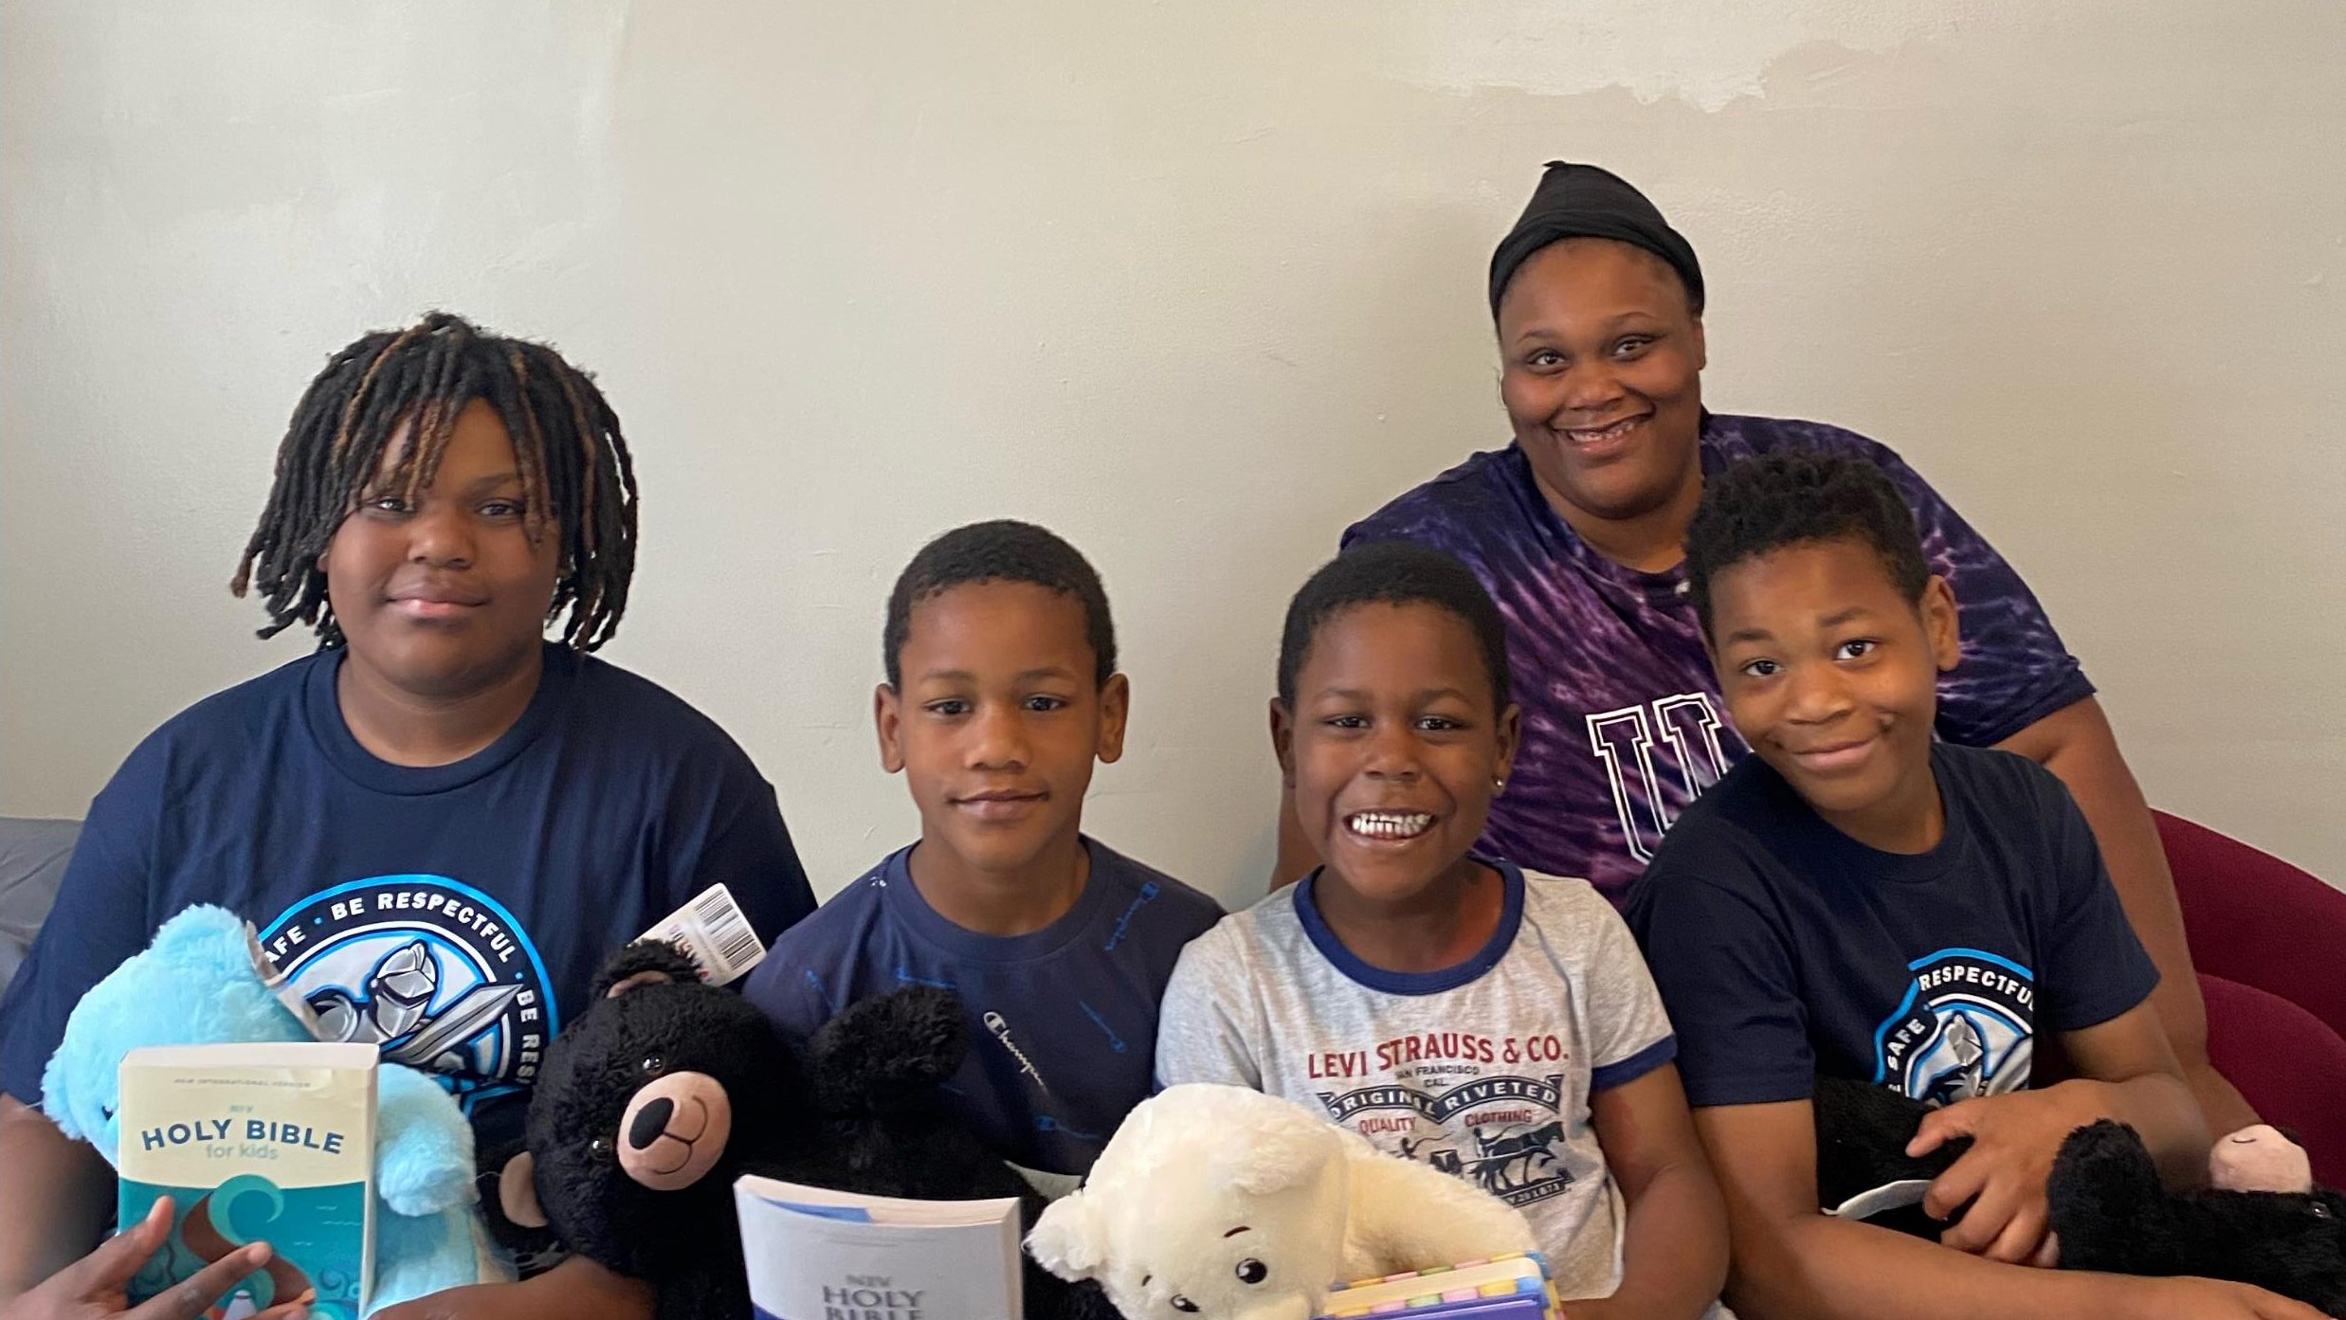

Slide 34
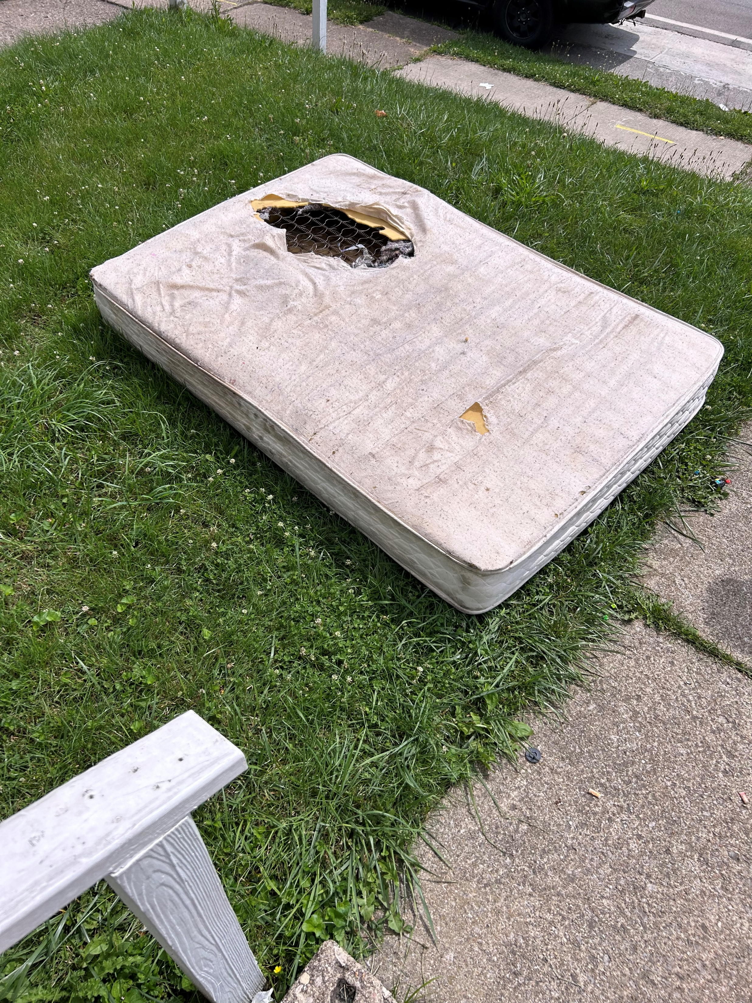

Slide 35


Slide 36
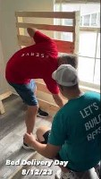
A short video of our team in action!
If you are having trouble with the video:
Click Here

Slide 37
How can you help!

Slide 38
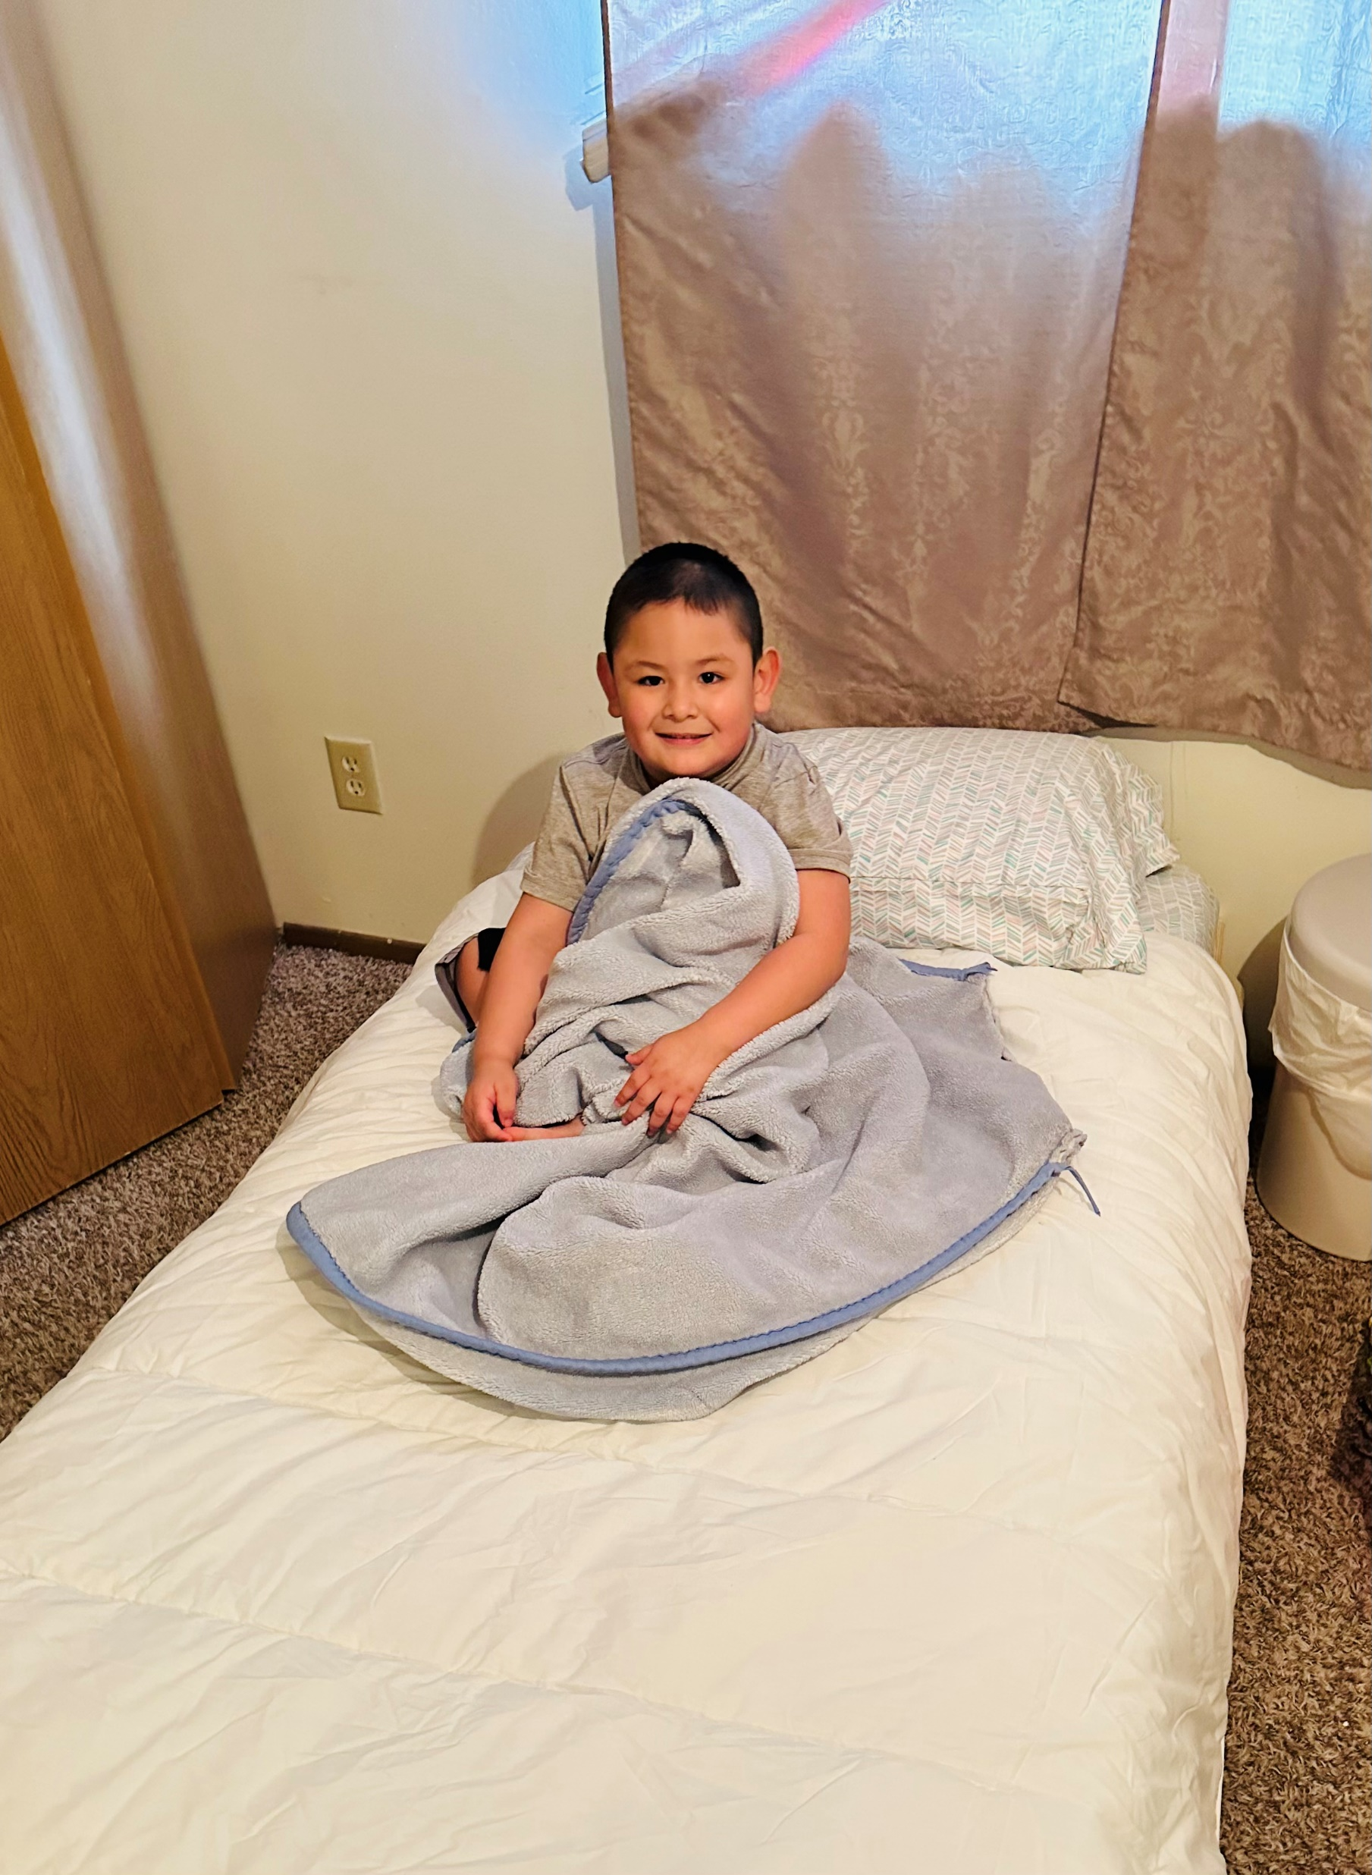
Pray
  We always welcome prayer for what we are doing!

Slide 39
Give Financially
  It costs about $100.00 to build and deliver a fully dressed bed
$60.00 – Wood and materials
$35.00 – Bedding, blanket, and pillow
$5.00 – Bible and literature

Slide 40
Give Time
  We have hundreds of people just in Central Ohio waiting on a bed.
  If you have time, we can arrange a delivery.

Slide 41
Give Muscle
  We try to have a build the 2nd Saturday of every month.
  We love it when people can come over and get their hands dirty.

Slide 42
Give Socially
  We are trying to spread the word. So many great people are willing to help but have no idea that bed insecurity is a problem.
  Connect with us on Facebook, Instagram, or any other social.
  WE NEED TO SPREAD THE WORD!

Slide 43
Give During an Event
  Our 2023 Sleep-A-Thon kicks off in October.
  Consider joining in and reaching out to your network for support.

Slide 44


